Slide 1
Introduction to Fluid Power
Prof. Jari Vepsäläinen

Slide 2
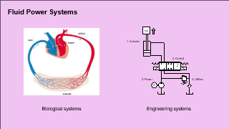
From a mechanical engineering perspective
The world
Consists mainly of…
Solids
Fluids
Physics: Statics, dynamics, thermodynamics,
kinematics, mechanics…
Data: capturing things we can’t explain with physics
FEM
CFD
Notes:
As Engineergs, we want to understand the world. How does it behave so that we can design systems that elegant, reliable, esthetic and efficient

Slide 3
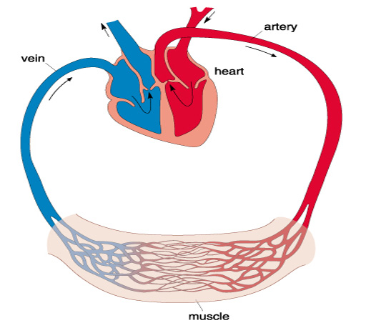
Fluid Power Systems
Biological systems
Engineering systems

Slide 4
Intended learning outcomes
After this session, the student can…
Understand the fundamental principles of fluid power
Identify hydraulic system and its components
Understand the working principles of hydraulic components
Identify fluid power applications

Slide 5
Contents
What is Fluid Power?
Fluid Power Systems
Applications and Research

Slide 6
1. What is Fluid Power?

Slide 7
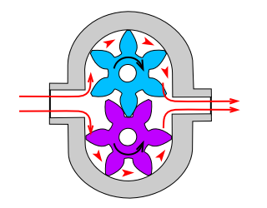
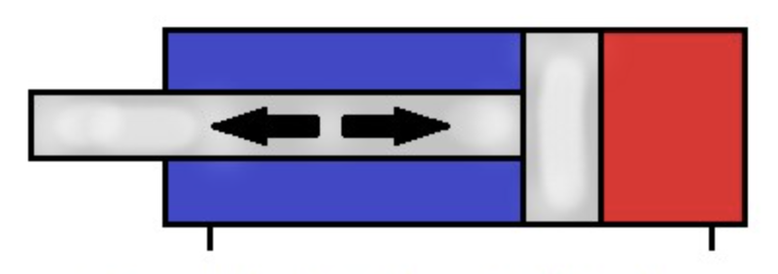


Linear
Rotational
Fluid Power
Liquid = Hydraulics
Gas = Pneumatics
Notes:
Gas is elastic and Liquid is stiff

Slide 8
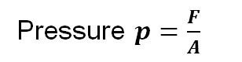

How it works?
Power transmission with fluid
Distribution of power
Power = Pressure x Flow
$$P=q_{v}Δp$$
Generation
Use
F_{in}
F_{out,1}
Pressure $p=\frac{F}{A}$
F_{out,1}

Slide 9
No pressure – no motion
Why this doesn’t work?
Pressure difference causes flow.
Without pressure, there is no flow.
Low pressure
High pressure
M

Slide 10
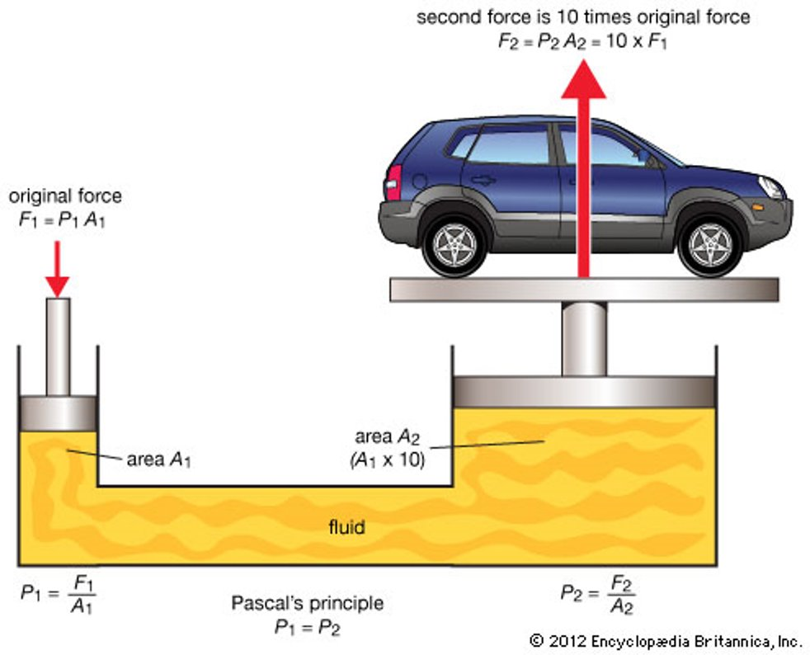
Hydraulic force conversion
Two cylinders
Same pressure, bigger area for lift
Higher force, lower speed
Power transmission

Slide 11
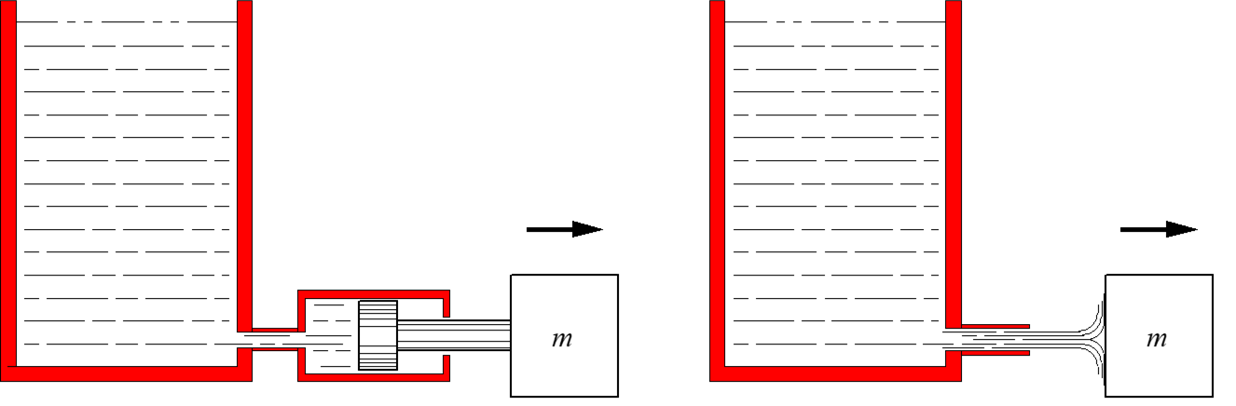
System types
Hydrostatic system
Hydrodynamic system
Force mostly linked to pressure p
Force mostly linked to flow q_{V}
h
p = ⍴gh
F
F

Slide 12
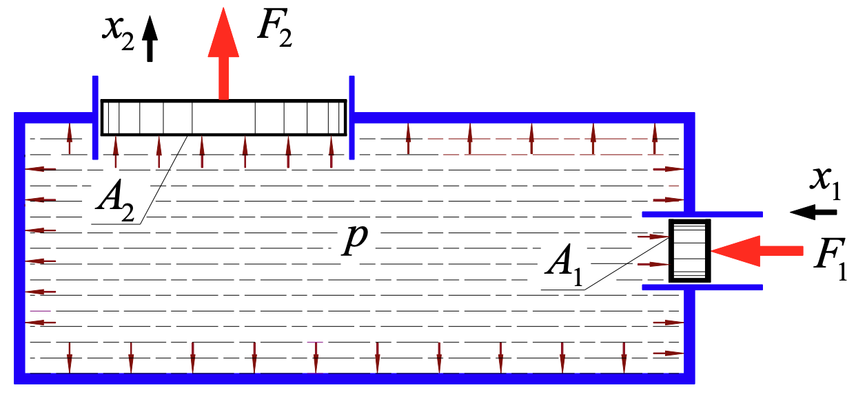
Pressure affects perpendicularly
Pressure is the same everywhere in the same volume

Slide 13
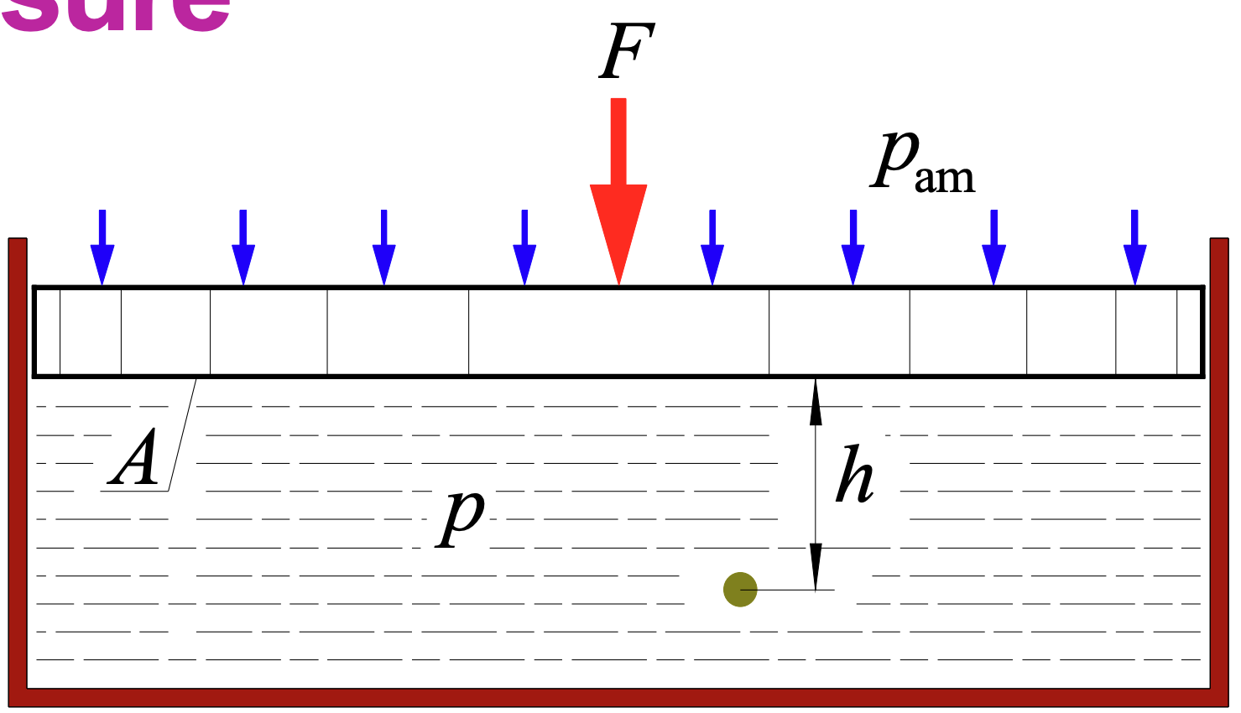
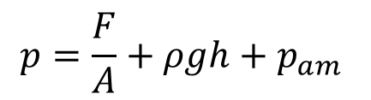
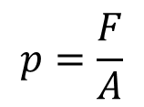
Absolute pressure
Units
SI Unit Pascal: 1 Pa = 1 N/m²
105 Pa = 1 bar (engineering unit)
Based on Bernoulli’s equation
$$p=\frac{F}{A}+ρgh+p_{am}$$
Gauge pressure
$$p=\frac{F}{A}$$
Notes:
Hydraulic oil density = 833.3 kg/m^3
h = 0.5 m (big cylinder)
g = 9.81
Rho*g*h = 4087.3365 pa = 0.04 bar
Atmospheric pressure 101,325 Pa = 1,01325 bar

Slide 14
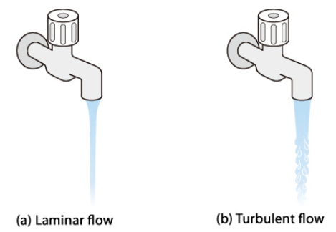
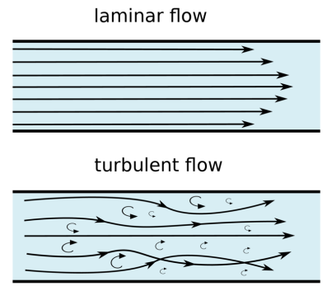
Flow
Laminar flow
Smooth and streamlined, low internal resistance
Turbulent flow
Chaotic and irregular -> Energy loss
Depends on
Pipe size
Fluid viscosity
Speed

Slide 15
2. Fluid Power Systems

Slide 16
System Components
Power source
Electric motor or engine + pump​
Actuators to convey movement
Cylinders and motors
Valves for logic & control
Fluid to convey power
Oil or water​
Utilities
Pressure accumulator, heat exchanger, filters, tank

Slide 17
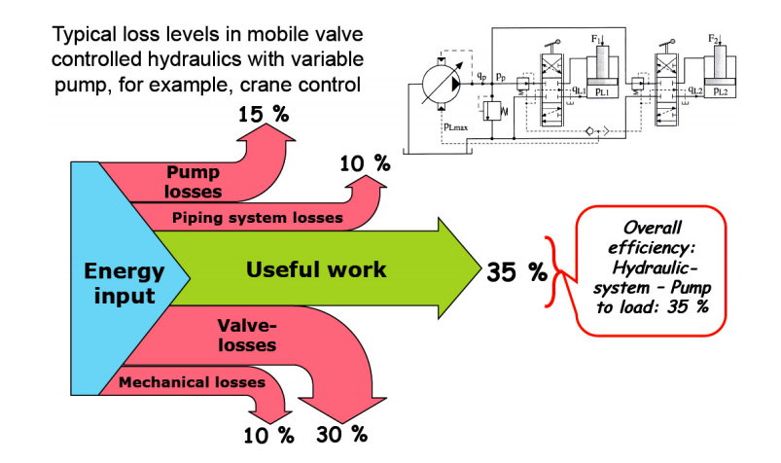
Energy losses
If idling is taken into account, average efficiency can drop to 20 %
K.-E. Rydberg, "Energy Efficient Hydraulics – System Solutions for Minimizing Losses," in National Conference on Fluid Power, "Hydraulikdagar'15", Linköping, Sweden, 2015.

Slide 18
Basic Hydraulic system
mg
1. Actuation
2. Control
3. Power
4. Utilities
M

Slide 19
“Powerpack”: eMotor/Engine + Pump

Slide 20
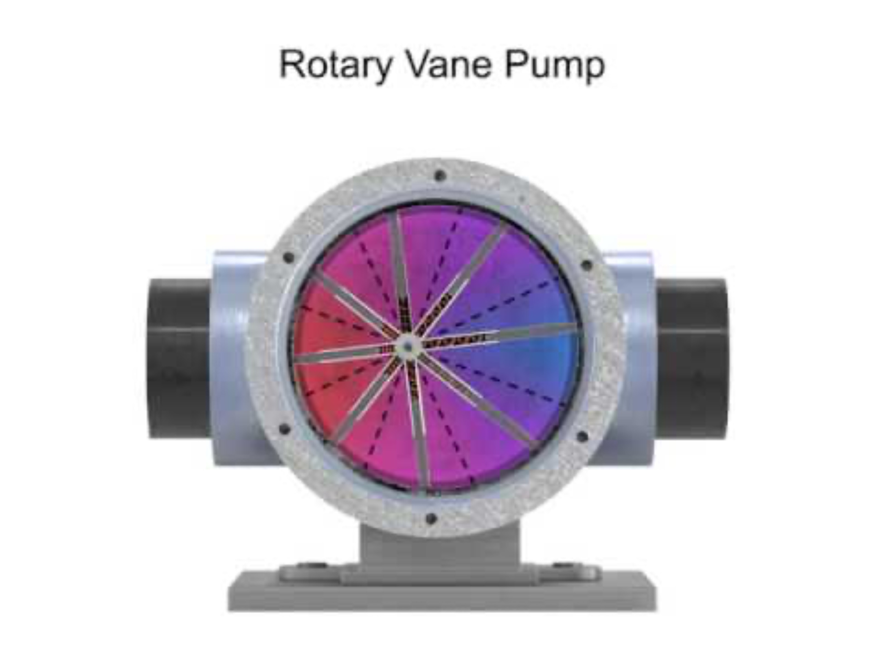
Video (8 min)
Bent axis pump

Slide 21
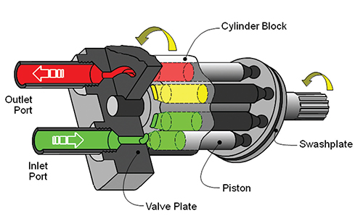
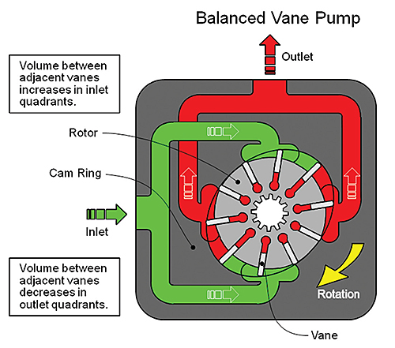
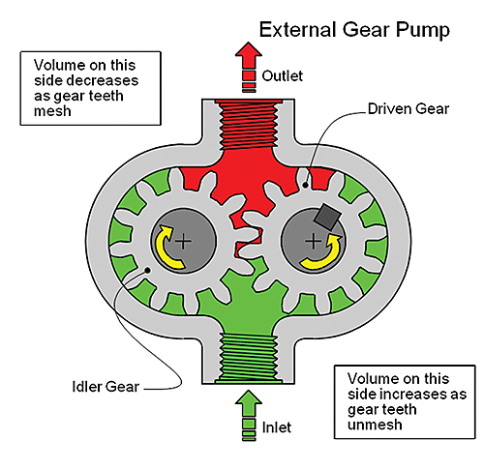
Pumps
http://www.designworldonline.com/a-quick-and-easy-guide-to-hydraulic-pump-technology-and-selection/#_
Notes:
Gear pumps simple and cheap (200 €). Can be noisy. Gerotor pump is an improved version (ei kuvassa). Fixed displacement
Piston pump for high pressure. Good efficiency. Can be variable displacement. Axial version driven by an angled swash plate. Also radial piston pumps available.
Vane pumps are quiet. Can also be variable displacement.
Friction and leakage.
Generally:
Gear type: p_{max} ≈ 17 − 25 MPa η_{t} ≈ 0,7 − 0,85
Vane type: p_{max} ≈ 7 − 25 MPa η_{t} ≈ 0,8 − 0,9
Piston type: p_{max} ≈ 16 − 45 MPa η_{t} ≈ 0,85 − 0,95
Displacements: V_{k} ≈ 1 − 1000 cm³/r
Motor types are basically the same.
https://www.youtube.com/watch?v=MdesnTOpkCM
https://www.youtube.com/watch?v=a00nMBsfdS0

Slide 22
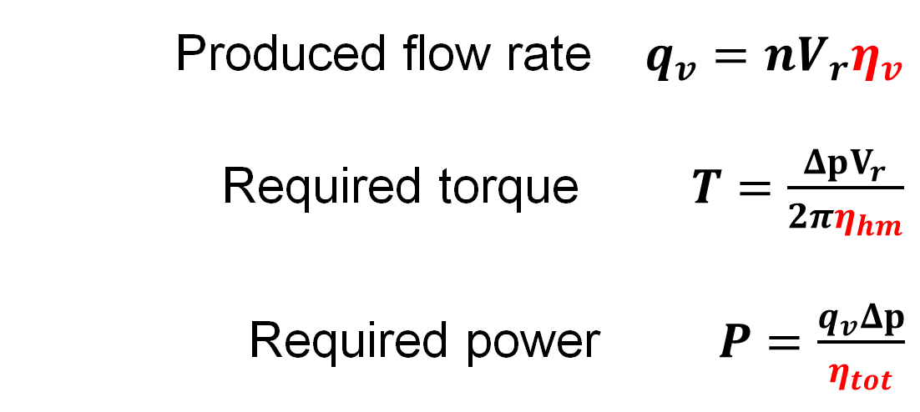
Pump equations
Ideal and real values for flow, torque and power
Produced flow rate $q_{v}=nV_{r}η_{v}$
Required torque $T=\frac{ΔpV_{r}}{2πη_{hm}}$
Required power $P=\frac{q_{v}Δp}{η_{tot}}$
n = Rotational speed [r/s]
V_{r} = Displacement [m³/r]
Δp = Pressure difference between inlet
and outlet [Pa]
q_{V} = Flow rate [m³/s]
η_{v} = Volumetric efficiency []
η_{hm} = Hydromechanical efficiency []
η_{t} = Overall efficiency []
= η_{v} ⋅ η_{hm}
More torque and rotational speed ⇒ input power
needed because of
Friction (hydromechanical efficiency)
Leakages (volumetric efficiency)
than in ideal pumps

Slide 23
Pump efficiency
η_{v} : volumetric efficiency (leaks)
η_{hm} : hydromechanical efficiency (flow and mechanical frictions)
η_{t} : overall efficiency

Slide 24
Actuation: Rotational and Linear

Slide 25
Motors
Often exactly the same structure as in a pump
Types
Axial piston
Bent axis
Radial piston
Gear
Vane

Slide 26
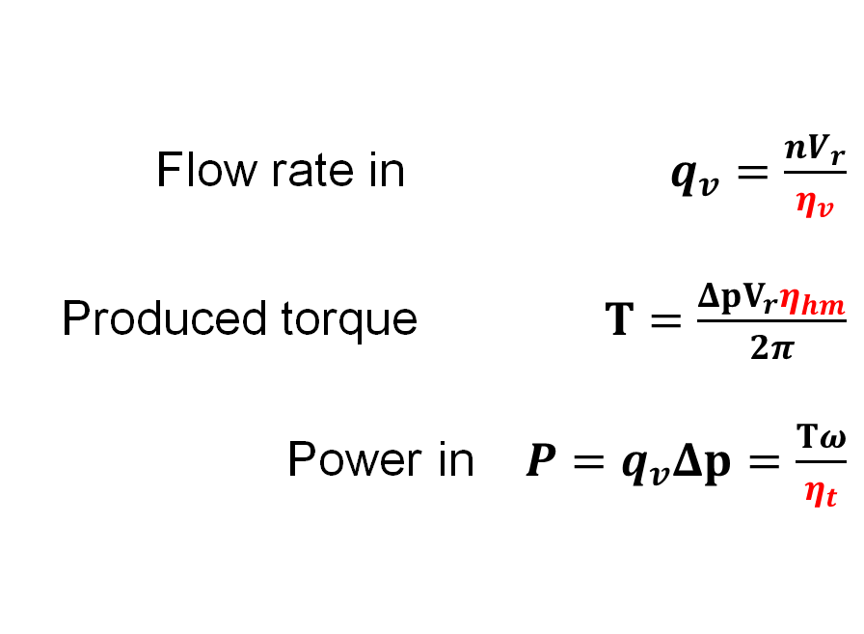
Motor equations
Efficiency is taken into account inversly compared to pumps
Flow rate in $q_{v}=\frac{nV_{r}}{η_{v}}$
Produced torque $T=\frac{ΔpV_{r}η_{hm}}{2π}$
Power in $P=q_{v}Δp=\frac{Tω}{η_{t}}$
n = rotational speed [r/s]
ω = angular velocity [rad/s]
V_{r} = swept volume [m³/r]
T = load torque [Nm]
Δp = pressure difference between
in- and outlet [Pa]
q_{V} = flow rate [m³/s]
η_{v} = volumetric efficiency []
η_{hm} = hydromechanical efficiency []
η_{t} = overall efficiency []
= η_{v} ⋅ η_{hm}

Slide 27
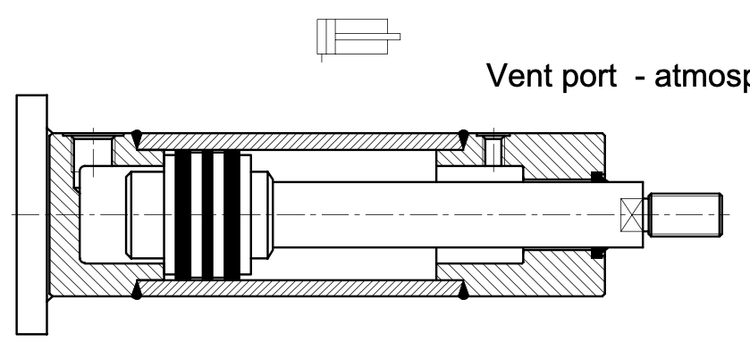
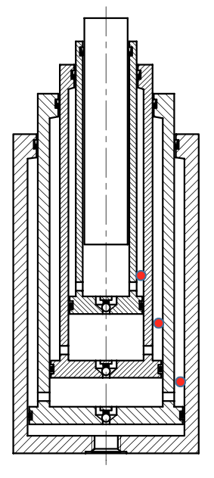
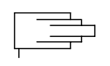
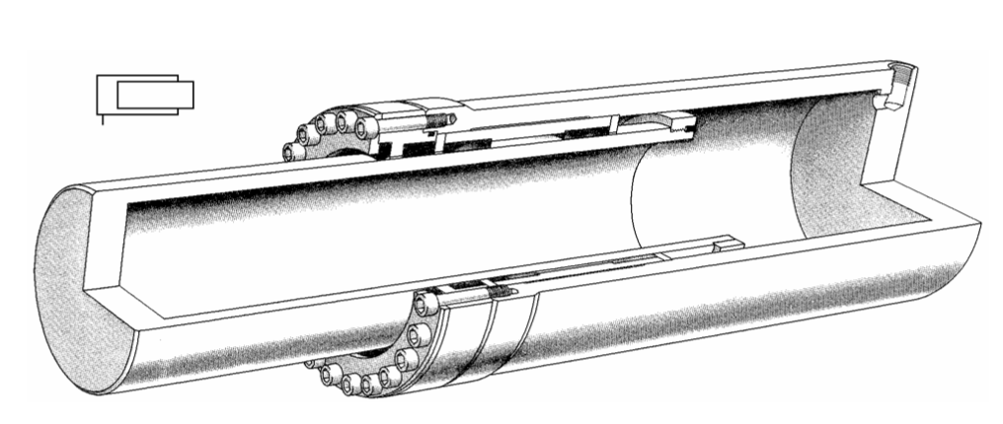
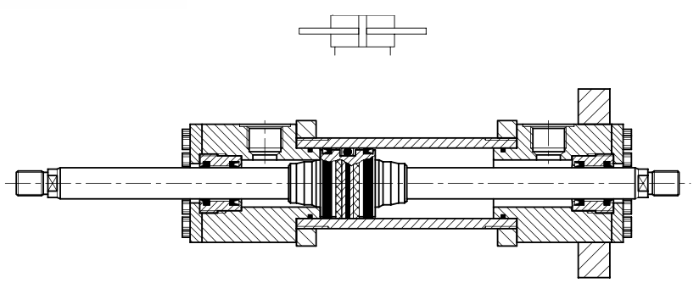
Cylinder Types
Single acting
Single or Double acting
Differential type:
Telescopic type:
Plunger type:
Non-differential (symmetric) type:

Slide 28
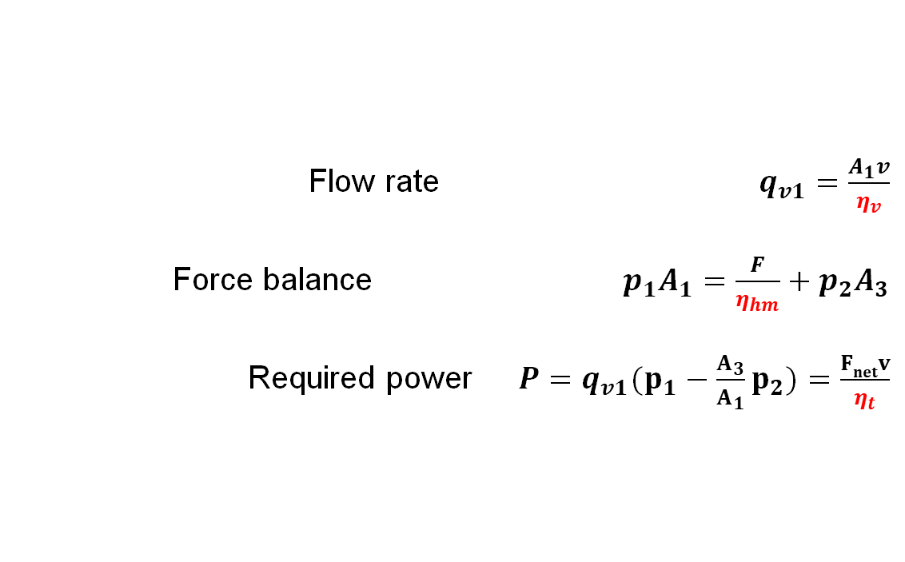
Cylinder equations
Flow rate $q_{v1}=\frac{A_{1}v}{η_{v}}$
Force balance $p_{1}A_{1}=\frac{F}{η_{hm}}+p_{2}A_{3}$
Required power $P=q_{v1}(p_{1}−\frac{A_{3}}{A_{1}}p_{2})=\frac{Fnetv}{η_{t}}$
A₁ = piston area on the working chamber [m²]
A₃ = piston area on the opposing chamber [m²]
v = piston speed [m/s]
F = external load force [N]
p_{out} = pressure on the opposing chamber [Pa]
η_{v} = volumetric efficiency []
η_{hm} = hydromechanical efficiency []
η_{t} = overall efficiency []

Slide 29
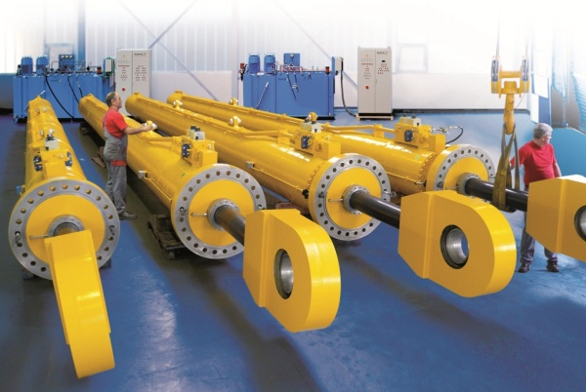
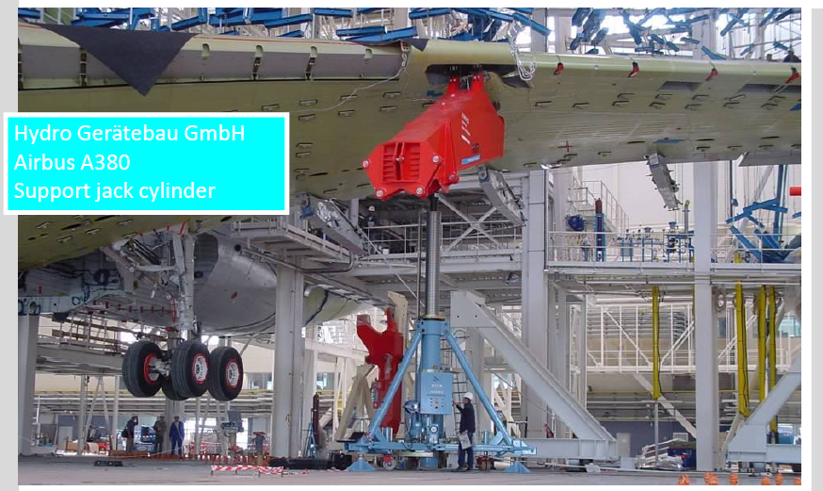
Cylinder size
D= 500 mm
@ 400 bar
7.7 MN
Lift 800 tons
AIRBUS A380 - Superjumbo
3 jacks
Cylinders made in Finland
Empty mass 277 000 kg
Notes:
If piston diameter 0.5 m, produced force at 40 Mpa ~7854 kN which equal lifting 800 000 kg.
Made in Ikkala, Lohja, Finland.

Slide 30
Control: Valves

Slide 31
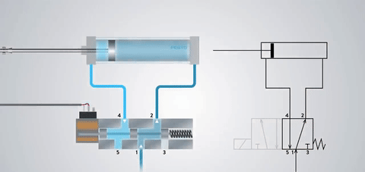
Directional Control Valves

Slide 32
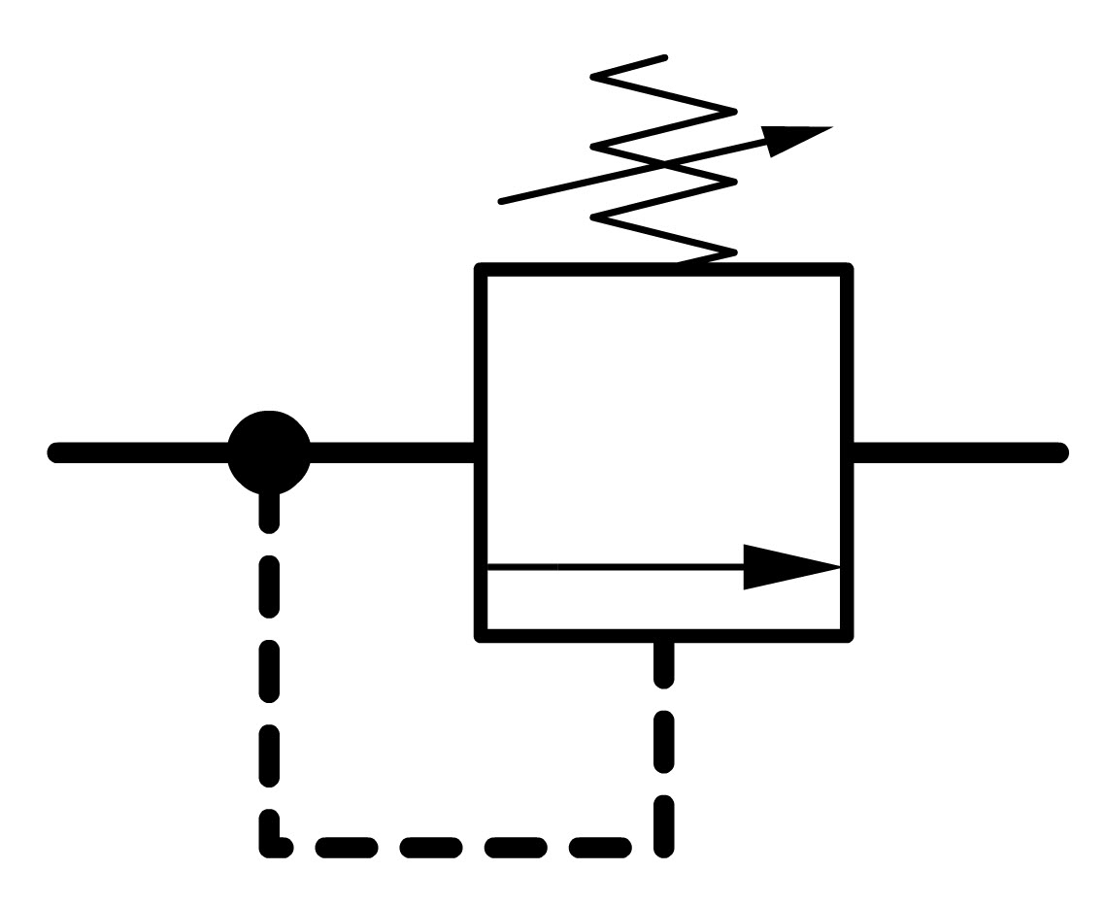
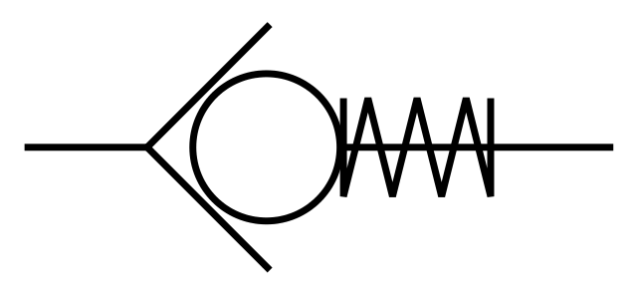
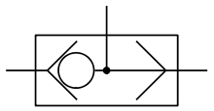
Other valves
Presure Relief Valve (PRV)
To protect from over pressure
Usually connects the protected line to tank
Necessary component in practice
Check valve
Block reverse flow direction
Shuttle valve
Choose the larger pressure level

Slide 33
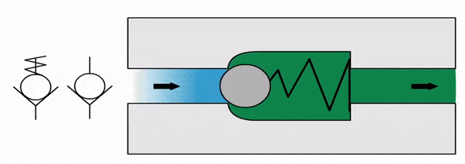
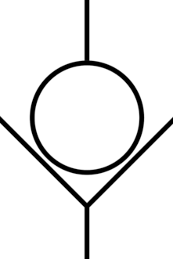
Check valve
mg
One-way operation
A
B
M

Slide 34
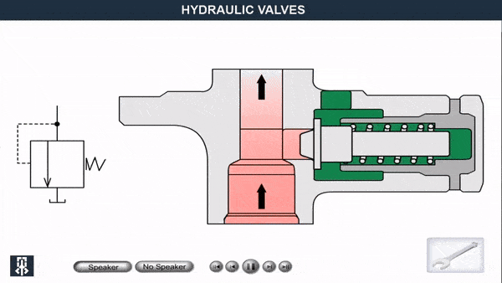
Pressure Relief Valve (PRV)
mg
M
Notes:
Think of it as a check valve that is really tightly wound.

Slide 35
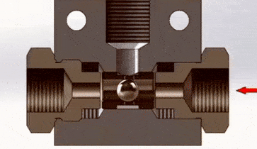
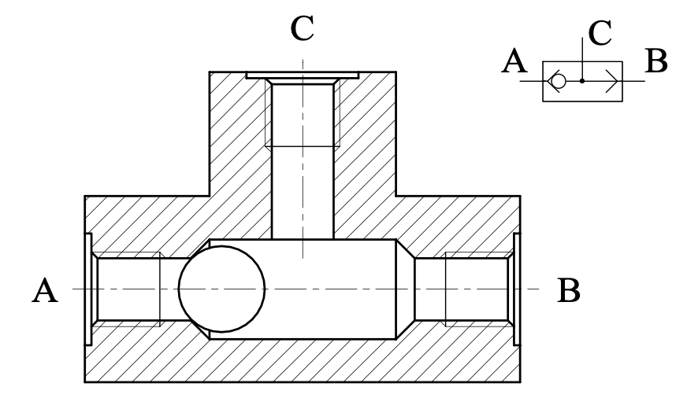
Shuttle valve
Pressure passes from higher pressure
Comparison between ports A and B

Slide 36
Energy Storage: Pressure Accumulator

Slide 37
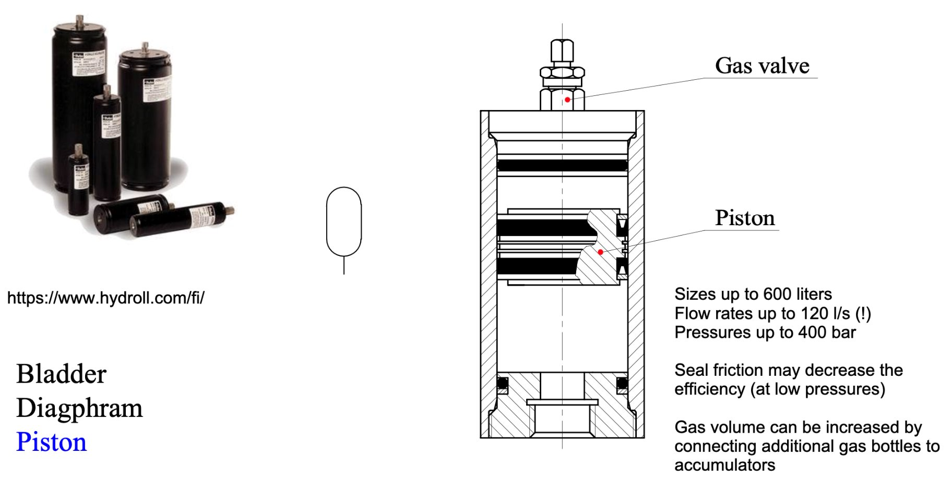
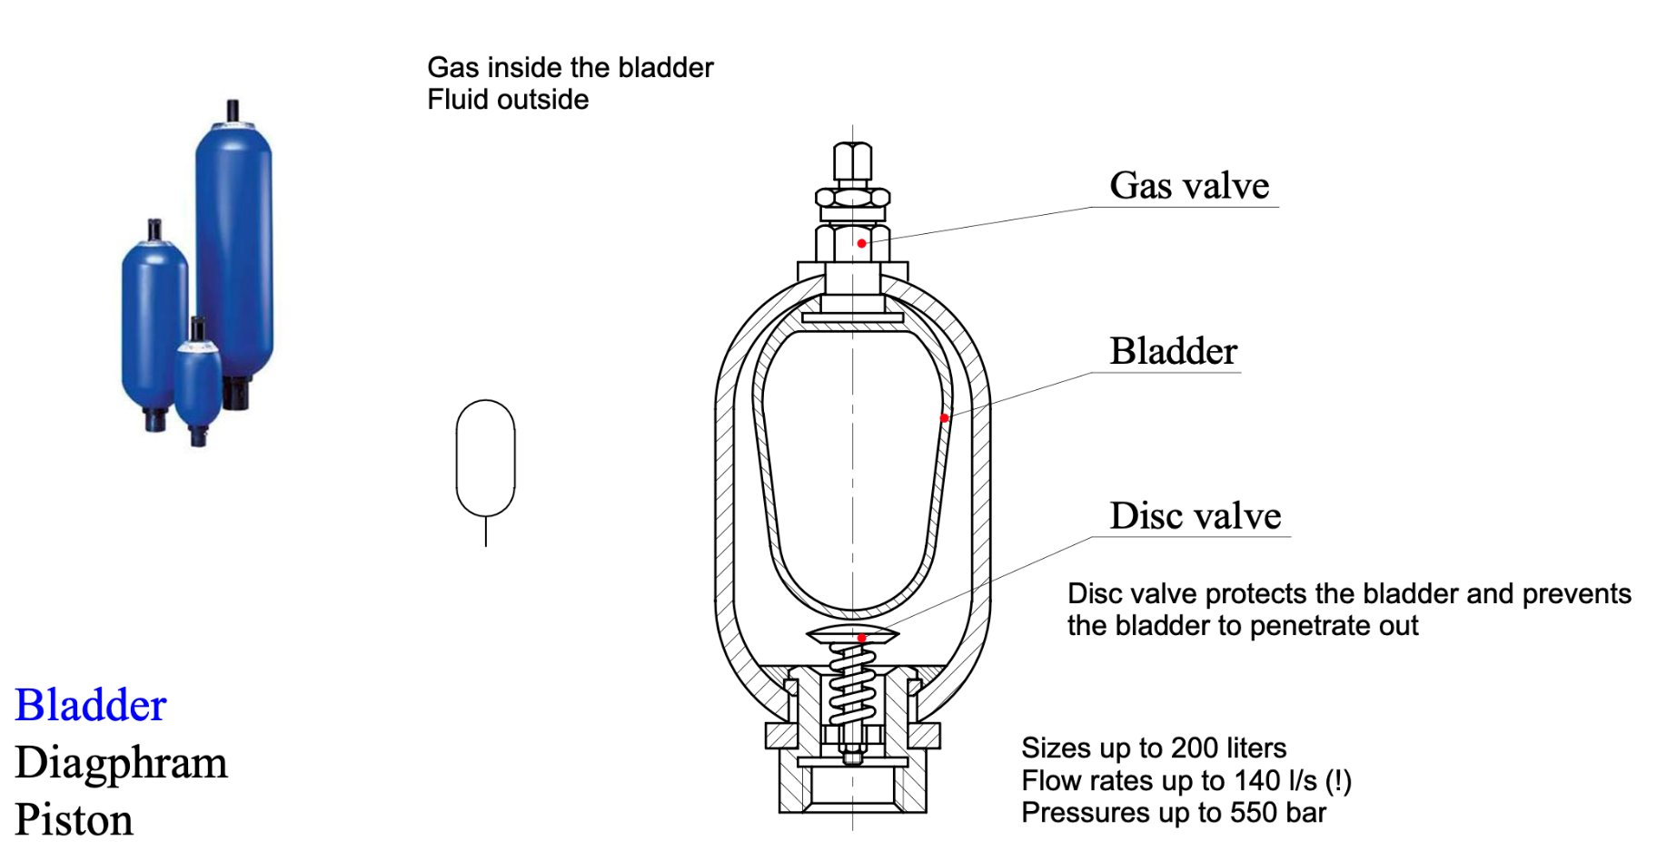
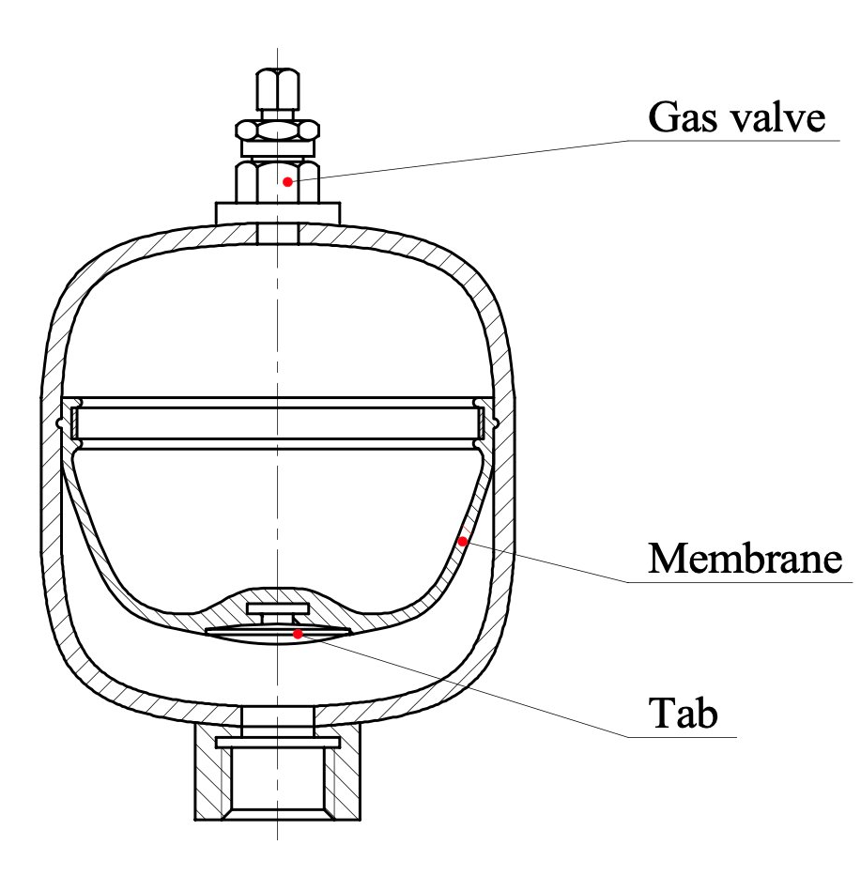
Pressure Accumulator
Energy storage
Fluid compresses nitrogen gas
Pressure depends on loading condition
Bladder
Membrane
Piston

Slide 38
System Architectures: Throttling vs. Pump control

Slide 39
Throttle control
Linear movement
 cylinder
Rotary movement
 motor
”Traditional system”
Constant Flow
Engine on one speed
Fixed displacement pump
< 40 % efficiency
Easy to control

Slide 40
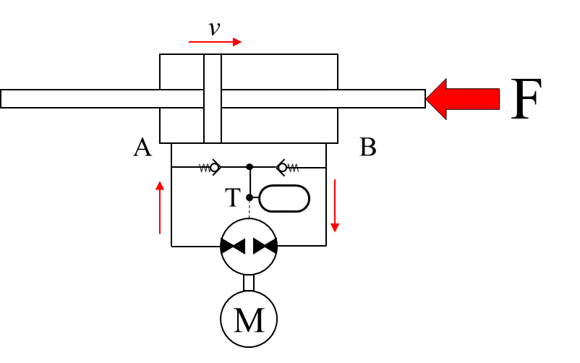
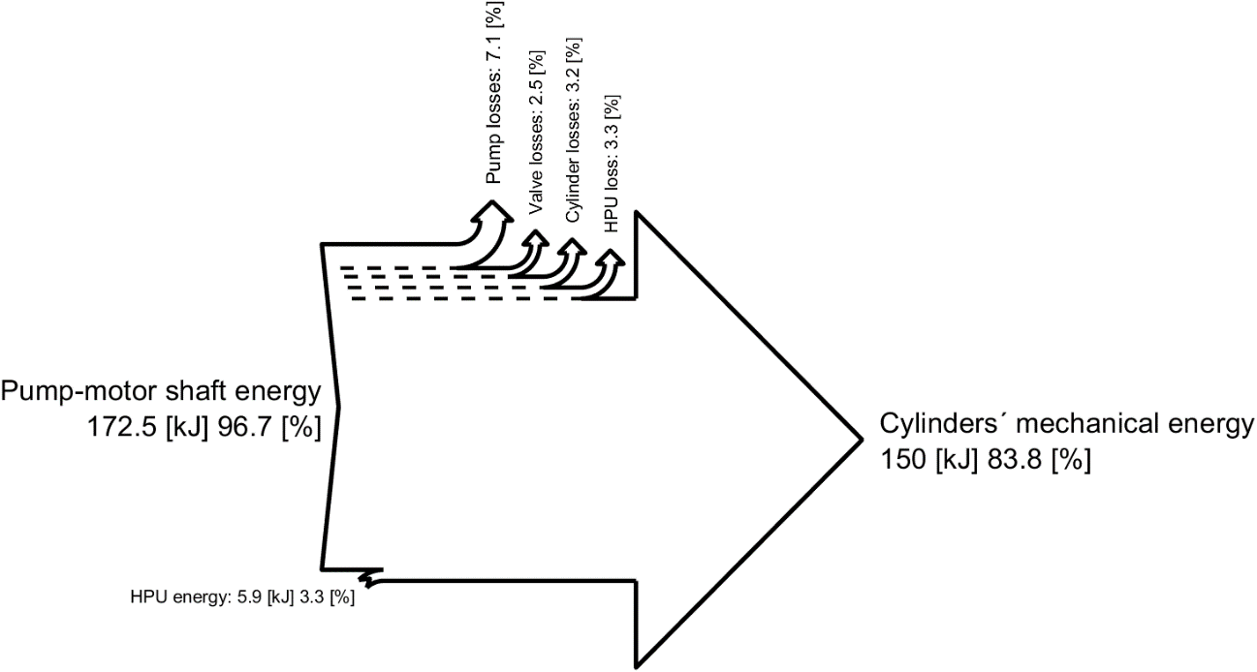
Pump Contro
Aka Electro-Hydraulic Actuation (EHA)
Electric motor controls the flow
No need for control valves
> 80 % efficiency
Difficult to control with varying loads and speeds
Hermansson, R. (2021). Testing and simulation of energy efficiency of direct drive hydraulic system. Master’s thesis.

Slide 41
Hydraulic fluids
Oil
Good lubricant
Environmental hazard
Health risk
Food industry
Expensive
Fire hazard
Viscosity index
Filtering
Metal chips, water, air
Water
Needs additives to lubricate
”Clean”
Expensive components
Can freeze
Corrosion
Stainless steel must be used (or even plastics for low pressures)

Slide 42
Fluid power systems
Pros
High power/weight –ratio
Linear and rotational motion
Robust control
Compliant if needed
Overload prevention
Freedom of system layout
Distributed power
Cons
Energy efficiency
22 % on avg.
New tech even over 80%
Characteristics of pressure medium
Leaks
Impurities

Slide 43
3. Applications and Research

Slide 44
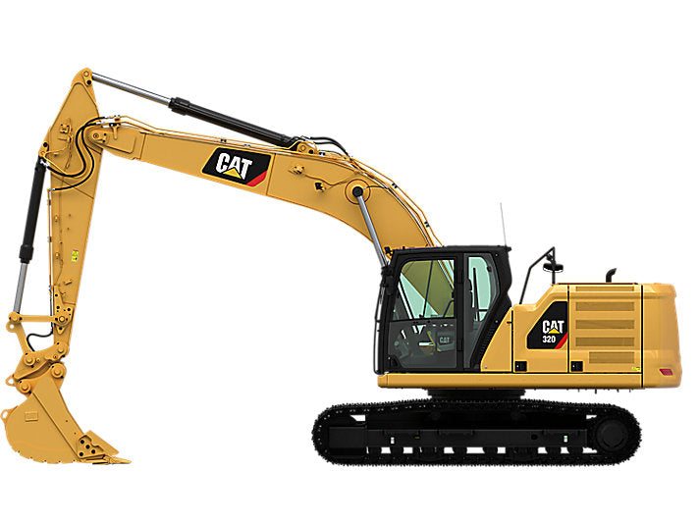
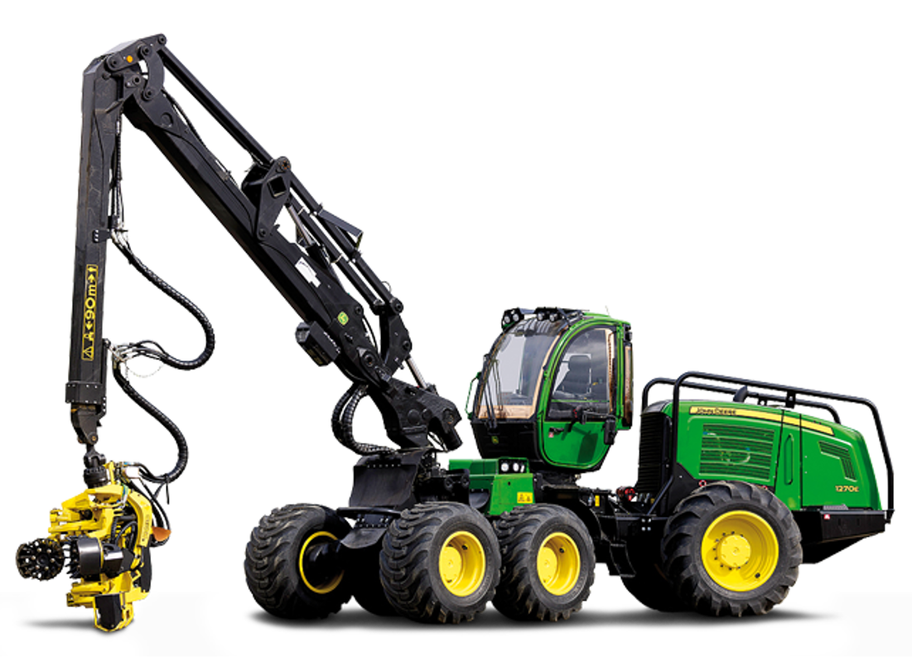
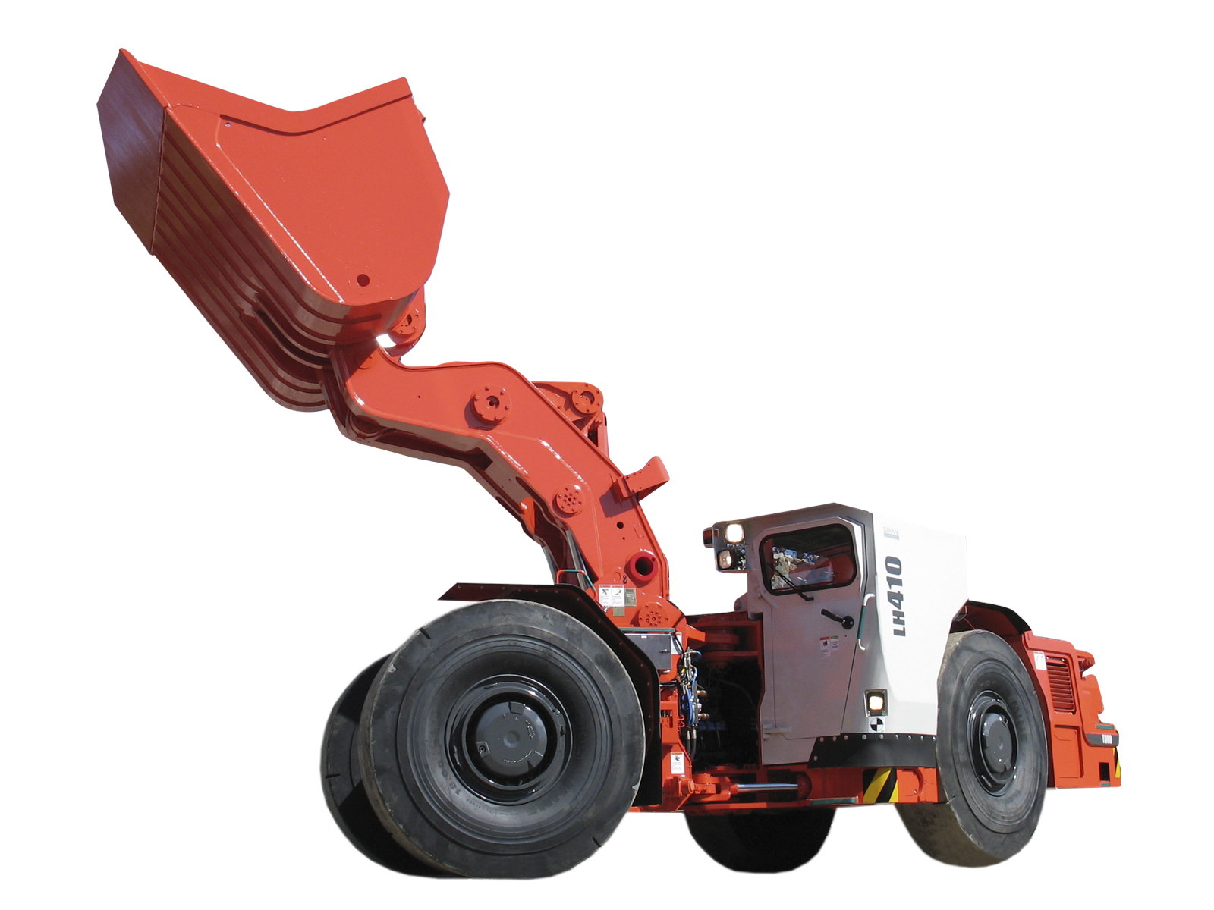
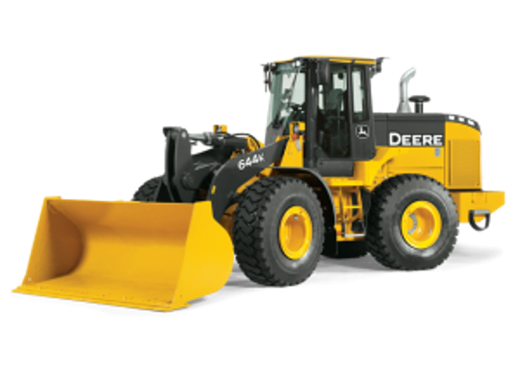
Workmachines
Excavator
Harvester
Wheel loader
Mining loader

Slide 45
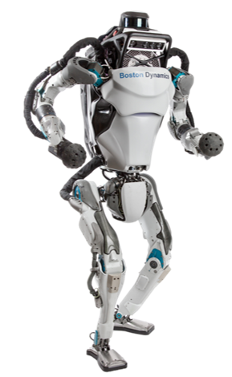

Boston dynamics: Atlas
28 hydraulic joints

Slide 46
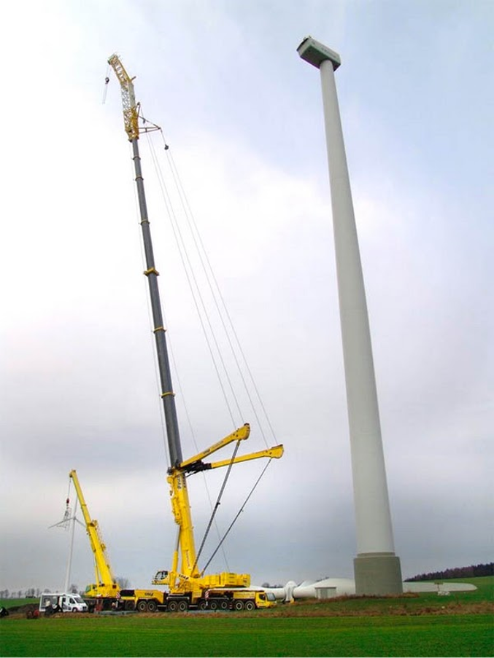
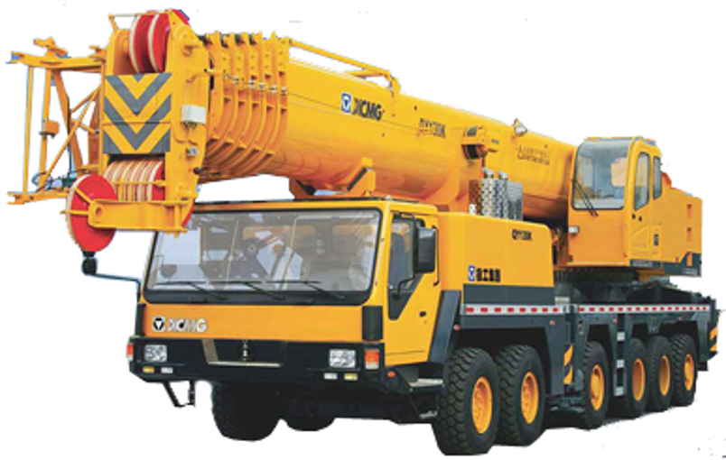
Telescopic crane

Slide 47
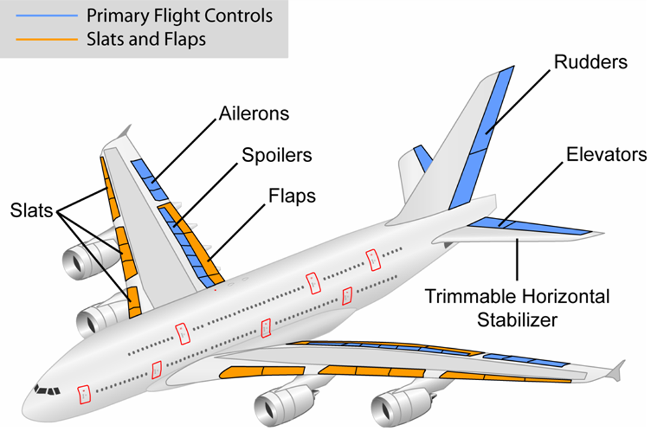
Airplanes
Elevator, rudder​
Landing gear​
Brakes​
Cargo doors, stairs

Slide 48

Hydraulic press
Forming sheets by pressing them​ into a mold with a huge force

Slide 49

Hydraulic brakes
Notes:
Anti-lock Braking system

Slide 50


Emerging Technologies
Exoskeletons
Aging population
Wave Energy Converters
Climate crisis

Slide 51


Pneumatics
Production Line automation
- fast actuation

Slide 52



Soft grippers
Compliant grip
Usually coupled with force sensing or haptic sensing
Notes:
https://www.youtube.com/watch?v=DeZ2-Y7l4ic

Slide 53

Soft gripper

Slide 54



Pneumatic muscles
Very light weigth
Inherently compliant
Biomimetic
Notes:
https://www.semanticscholar.org/paper/A-Pneumatic-Biped-with-an-Artificial-System-Niiyama/6165ce0d28cdc28a64ca68aae82884e2130766d3

Slide 55

Research focus: Non-Road Mobile Machinery
There is a need for electrification to reduce emissions and improve efficency. High power requires large batteries and motors. Challeges:
Cost
Weight
Space
Heat
Challenge: Industry is very conservative, hard to introduce new solutions

Slide 56
Research Topics Breakdown
Non-Road Mobile Machines
System Design
Improved Performance
Increasing Longevity
Thermal Design
Waste Heat Utilization
Energy Recuperation
Vibration Damping
Predictive Maintenance
Optimizing Components
Managing Peak Loads
Phase Change Materials
Adsorption Materials
Cooling Dimensioning
Notes:
Energy Recuperation
Juhon tutkimus hydrauliarkkitehtuureissa, jossa hyödynnetään kineettistä ja potentiaalienergiaa toisista aktuaattoreista. Hyvin riippuvianen työsyklistä
Tarvitaanko Improved Perfomance alle Alternative Powertrains? Ei varmaan tartte mainita
Optimizing Components
Downsizing – using smaller motors which are coupled for peak loads – Topias’s work
Hydrauliikka venttiililohkon suunnittelu tekoälyavusteisesti? DriveForward, jatkoa Tapio Lantelan työlle – Jaakim? Juho? Uusi tyyppi? Voisi mennä myös WP4.DF
- Optimoitu tilan ja flown kannalta
- 3D printing
Vibration Dampening
Active control - Oliver
Waste Heat Utilization
Paineakkututkimus: Nanothrust -> DriveForward
Kivin nykyinen tutkimus paineakkujen energiatehokkuuden parantamiseksi jatketaan NanoThrustissa. Ainakin Hydrollilla olisi tähän kiinnostusta, heidän omassa tutkimussuunnitelmmassaan tästä on mainittu. Hyvä jatkumo. Jyri Juhala aikanaan tätä tutki ja Juuso teki dipan, mutta enemmänkin nopeita testejä eikä tehtyy pitkää selkeetä tutkimusta.
Nanothrust reaktori
Anna-Kaisa, Gabe, Ali, Heikki
Managing Peak Loads
PCM – Ali (FCPT funding! 2 years?)

Slide 57
Summary
Hydraulics is a power transmission method​
Pressure differences required to create flow
High forces and power from compact actuators​
Good efficiency actuators, often bad efficiency systems
Hydraulic system consists of​
Powerpack: eMotor/Engine + Pump​
Actuators: Cylinders and motors
Valves: Directional and Control
Sensors: pressure, flow, position, force, temperature​
Fluid: oil, water​
Utilities: Pressure accumulator, heat exchanger, filters, tank

